Slide 1
Topic 6: competition, Market failures, and welfare
Antitrust Economics 2013
David S. Evans
University of Chicago, Global Economics Group
Elisa Mariscal
CIDE, ITAM, CPI
Topic 6 | Part 2 13 June 2013
Date

Slide 2
Overview
Part 1
Transaction Costs
Part 2
Opportunistic Behavior
Contractual Solutions
Theory of the Firm
Welfare and Efficiency
Market Failures
Economics of Remedies
Antitrust, Welfare and Market Failure

Slide 3
Welfare and Efficiency

Slide 4
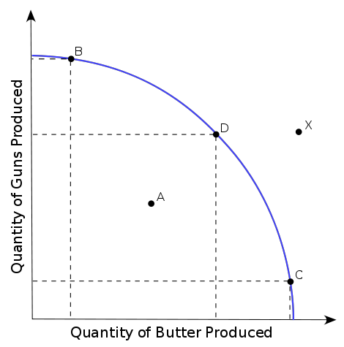
Concepts of efficiency
Productive efficiency occurs when it isn’t possible to get more output from existing resources so firms are operating at their lowest possible cost.
Allocative efficiency occurs when there is no way of reorganizing production and distribution to make at least one person better off without making anyone worse off (i.e. to make a Pareto optimal improvement).
Pareto optimality occurs when it is not possible to make at least one person better off without making anyone worse off given the possibility of winners paying off losers.
Notes:
So I usually include static and dynamic efficiency here too.

Slide 5
Perfect competition and economic efficiency
Perfect competition should also lead to productive efficiency since firms in perfectly competitive markets are forced to maximize the amount of production they get from inputs; in fact we assume firms attempt to minimize the cost of producing any given level of output.
Perfect competition leads to allocative efficiency where the marginal cost of output for every industry equals the marginal benefit of production. That occurs where supply schedule which reflects marginal cost intersects demand schedule which reflects benefits of each additional unit of output
Costs
MC
P
Supply
ATC
AVC
Demand
Q
Q
Notes:
Alexis can you add one of the graphs showing Demand, Supply on Social Welfare

Slide 6
Consumer and producer surplus
Value
Maximum Amount Consumers Would Pay
Consumer Surplus
Price
Cost to society
Producer
Surplus
Output
Social welfare=Consumer plus Producer Surplus (green plus blue triangles)
Notes:
Consumer “surplus” is how much value people get over and above what they have to pay
If business practices increase consumer welfare then we should not want competition policy to prohibit these practices.
If business practices reduce consumer welfare and are subject to competition law we should want to prohibit these practices.

Slide 7
Perfect competition can lead to efficiency, but …
Perfect competition requires extreme assumptions including no transactions costs, perfect information, and atomistic production (no scale economies).
Even then, perfect competition won’t lead to economic efficiency if there are “externalities” so that transactions do not account for all costs and benefits—we discuss this further in the next section.
In fact, the most “efficient” market structure from both a static and dynamic perspective really depends on the details of the industry. For example, with “natural monopoly” resulting from cost or demand-based scale economies single firm most efficient.
Notes:
Alexis can you add one of the graphs showing Demand, Supply on Social Welfare

Slide 8
Efficiency, welfare, and antitrust
Consumer versus social Welfare. Do firms (producer surplus) count?
They should to attain allocative efficiency which is an economy-wide concept.
Society can always tax profits and redistribute (not perfectly though).
Firms are owned by people and widely owned in some developed economies.
Whose welfare?
All consumers in the market?
What if some consumers benefit and others lose (and what does this say about submarkets?)
Consumers on both sides of two-sided platforms?
Do we weight some “consumers” more—such as small businesses.
Should competition authorities focus on consumer welfare?
Maybe firms can fend for themselves, but not consumers.
Why do competition authorities treat firms as consumers when they are buyers?

Slide 9
Market Failures

Slide 10
Market failure
A market failure occurs when unregulated market forces do not result in allocative efficiency.
It is therefore possible that an intervention in the market could result in a Pareto optimal improvement.
Market failures include asymmetric information, transactions costs, externalities, public goods, and ineffective competition.
Notes:
Alexis can you add one of the graphs showing Demand, Supply on Social Welfare

Slide 11
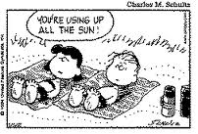
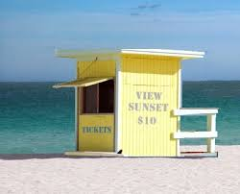
Public goods
Non-excludable—A good where it is not possible to prevent another individual from using the same good.
Non-rivalrous—One person’s use of a good does not reduce the amount another person can consume; the marginal cost of consuming the good is zero.
Examples include knowledge. It is not possible to prevent anyone from using the Pythagorean Theorem, to hum the opening of Beethoven’s Fifth, or benefit from a street lamp or a public park (or is it?).
Notes:
Alexis can you add one of the graphs showing Demand, Supply on Social Welfare

Slide 12
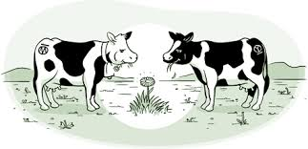
Common—or jointly used—goods
Exclusion—Some resources are freely available unless society adopts rules to exclude people, e.g. charge for use of public parks.
Rivalry—For these common goods at some point one person’s use reduces or interferes with another person’s use.
The Tragedy of the Commons refers to the overuse of a common good. The bucolic example is a town that has a common for grazing sheep. Without restrictions too many people graze their sheep and the common is destroyed. (Prisoner’s dilemma—everyone is worse off from independent decision-making.)
Notes:
Alexis can you add one of the graphs showing Demand, Supply on Social Welfare

Slide 13
Externalities
Externality—is a cost imposed or a benefit received that is not reflected in prices of other terms of trade between parties.
Positive externality—is a benefit that others receive but do not pay for, such as my neighbors who benefit from my flower boxes.
Negative externality—is a cost that others bear but do not get compensated for, such as loud neighbors.
These are non-pecuniary externalities. Pecuniary externalities are ones that involve external effects through pricing—more demand for fine wines raises my cost of buying wine or more demand for a product with scale economies lowers my cost.
Notes:
Alexis can you add one of the graphs showing Demand, Supply on Social Welfare

Slide 14
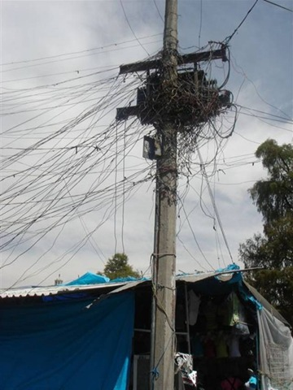
Free-Riding
Free riding involves any situation in which a party benefits without bearing any cost.
Free-riding could involve benefiting from public goods without bearing the cost of creating them by avoiding taxation or paying for your electrical bill, for example
Free riding could involve avoiding efforts to exclude a user from a common good or any property without paying.
Notes:
Alexis can you add one of the graphs showing Demand, Supply on Social Welfare

Slide 15
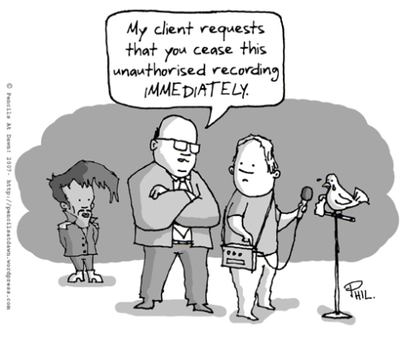
Public Goods and Intellectual “Property”
Products of the mind are non-rivalrous since once created they have zero marginal cost of replication.
Product of the mind are usually non-excludable once they are released.
The public policy question is under what circumstances and to what extent should we “exclude” the use of products of the mind by granting property rights.
Notes:
Alexis can you add one of the graphs showing Demand, Supply on Social Welfare

Slide 16
Economics of Remedies

Slide 17
Theory of first and second best
First-best intervention directly fixes a problem and restores allocative efficiency.
Second-best intervention tries to fix the problem indirectly, often by changing multiple economic variables, and may get closer or farther to allocative efficiency. It typically introduces other distortions.
For example, if cigarette smoking imposes a $1 per pack “negative externality” from second smoke then we could impose a $1 per pack tax on the buyer.
Usually a first-best intervention is not feasible. The question is whether the second-best intervention increases social welfare after taking all costs into account, including the costs of creating other distortions.
For example, we could ban cigarette smoking around people. Smokers might have lower welfare (should we care whether the smoker is making a bad decision for themselves?) but other people might have higher welfare.
Notes:
Alexis can you add one of the graphs showing Demand, Supply on Social Welfare

Slide 18
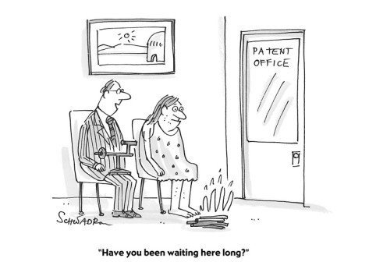
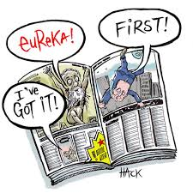
Assessing optimal remedies
What other distortions does a remedy for a market failure introduce and what are the costs of those distortions?
What the the costs of administering the remedy?
For example, providing patent rights to deal with non-excludability could result in “monopoly power” that could lead to deadweight loss.
For example, patent rights lead to costs of establishing a patent office and a legal system for addressing such rights.
How likely and costly are unintended consequences of a remedy?
For example, some argue patent rights result in “tragedy of anti-commons” where there are too many conflicting rights over intellectual property leading to high transactions costs.
Notes:
Alexis can you add one of the graphs showing Demand, Supply on Social Welfare

Slide 19
Antitrust, Welfare and Market Failure

Slide 20
Antitrust and the monopoly problem
One view of antitrust is that it is a remedy for the monopoly problem. Monopoly creates deadweight loss (reduced allocative efficiency) and reduced consumer surplus.
“Textbook” first-best intervention is to force production at the competitive price and output either by mandate or by replacing monopoly with a competitive industry.
The “Textbook” solution doesn’t work because competition is not feasible or the best approach for achieving static or dynamic allocative efficiency.
In fact, US case law specifically repudiates the notion that antitrust without something more should prohibit obtaining and exercising monopoly power.
Antitrust, in fact, does not act as a remedy for the monopoly problem.
The US and most jurisdictions do not prohibit “monopoly” prices or prohibit firms from having monopolies.
Notes:
Alexis can you add one of the graphs showing Demand, Supply on Social Welfare

Slide 21
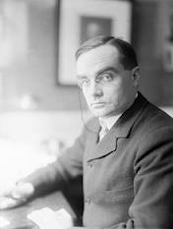
Antitrust and the monopoly problem
Judge Learned Hand’s famous quote summarizes the idea behind using antitrust to “solve” the monopoly problem
“A market may, for example, be so limited that it is impossible to produce at all and meet the cost of production except by a plant large enough to supply the whole demand. Or there may be changes in taste or in cost which drive out all but one purveyor. A single producer may be the survivor out of a group of active competitors, merely by virtue of his superior skill, foresight and industry. In such cases a strong argument can be made that, although the result may expose the public to the evils of monopoly, the Act does not mean to condemn the resultant of those very forces which it is its prime object to foster: finis opus coronat. The successful competitor, having been urged to compete, must not be turned upon when he wins.” United States v. Aluminum Corp. of America, 148 F.2d 416, 430 (1945)
Learned Hand
1872-1961
Notes:
Alexis can you add one of the graphs showing Demand, Supply on Social Welfare

Slide 22
Antitrust as a second-best remedy
Firms can adopt various practices that reduce static and dynamic allocative efficiency. Some of them may arise over the normal course of business, others may not.
Antitrust provides a framework for identifying business practices that can reduce efficiency, banning them or discouraging them to varying degrees.
Antitrust rules take lessons of optimal intervention into account—rule of reason analysis in US, Article 101(3) for Europe, etc.
Notes:
We have an interesting piece in CPI discussing rule of reason analysis by the chief economists in the US and UK: https://www.competitionpolicyinternational.com/economic-analysis-of-competition-practices-in-the-eu-and-the-us-a-view-from-chief-economists/ Economic Analysis of Competition Practices in the EU and the U.S.: A View from Chief Economists Michael Salinger, Dennis Carlton, Nov 05, 2007.

Slide 23
Antitrust remedies for violations
Structural remedies
Behavioral remedies
Breaking up monopolies (e.g. Standard Oil, US Bell System) and creating competition
Selective divestitures (particularly mergers, e.g. recent AB InBev/Modelo merger in the U.S.)
Prohibitions on resale price maintenance, tying, MFNs, etc. (e.g. banning exclusive dealings in carbonated beverages or sharing refrigerator space).
Price regulation
Public-utility style rate regulation (e.g. music collecting societies)
Development of remedies can learn from theory of optimal intervention
Notes:
Merger: Anheuser-Busch InBev merger with Grupo Modelo in a transaction valued at $20.1 billion. Divests Modelo's entire U.S. business -- including licenses of Modelo brand beers, its most advanced brewery, Piedras Negras, its interest in Crown Imports LLC and other assets -- to Constellation Brands Inc.
Mexico – structural remedies can now be applied in a more expedient fashion by the authority according to the new law. Behavioral remedies examples: carbonated beverages – sharing of refrigerator space, etc. problem is how to police these without incurring in high costs by the authorities, how to set up remedies in a way that gives incentives for parties to police themselves and discourages the violator from repeating the conduct.

Slide 24
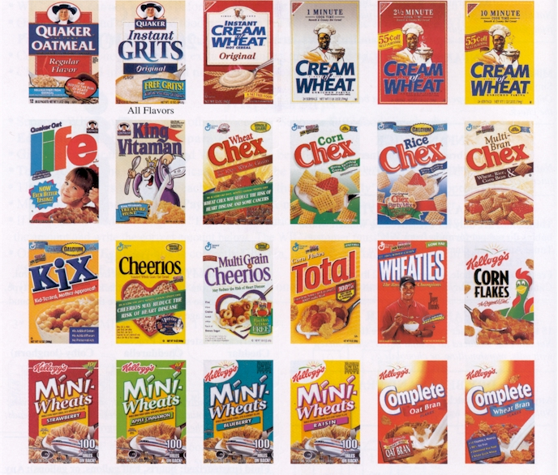
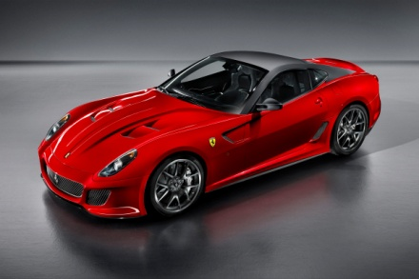
Applications of Product Differentiation
Litigation: Ready-to-Eat Cereals Case in the US.
Business: Differentiation of automobiles.
Notes:
Alexis can you add some of the pictures we’ve used throughout the course for these 2 examples?

Slide 25
End of Part 2, Next Class Topic 7: Multisided Platforms
Part 1
Economic Background of Two-Sided Platforms
One-Sided versus Two-Sided Businesses
Part 2
Strategies for Multi-Sided Platform Businesses
Antitrust Issues
Economic Principles
Market Definition for Multi-Sided Industries

