Slide 1
Topic 1: Economics of Competition Policy
Antitrust Economics 2013
David S. Evans
University of Chicago, Global Economics Group
Elisa Mariscal
CIDE, ITAM, CPI
Topic 1 | Part 2 14 February 2013
Date

Slide 2
Overview
Part 1
The importance of economics to the practice of antitrust
How is the course going to help you learn antitrust economics
Competition and why we care about it
Part 2
The basic economics of competition policy
The design of competition rule

Slide 3
Basic Economics of Competition Policy
The key concepts for understanding the economics of antitrust

Slide 4
Demand, Supply and Static Competition
Demand schedule reflects how much consumers are willing to pay and therefore how much they value particular amounts of production.
Supply schedule reflects how much producers would have to be paid to offset their costs for particular amounts of production.
Competition among producers drives output to the point where additional cost of production just equals additional value to consumers.
That maximizes consumer welfare! (And maximizes social welfare too!)
Notes:
Concept of opportunity cost

Slide 5
Consumer versus social welfare
Consumer welfare is the difference between the value each individual places on a good or service they purchase (measured by the maximum they are willing to pay) and the price they pay for it.
Social welfare is the difference between the value each individual places on a good or service they purchase (measured by their maximum willingness to pay) minus the cost to society of the scarce resources that went into providing that good or service.
Roughly speaking the difference between social welfare and consumer welfare goes to firms as profits which then get distributed to their shareholders.

Slide 6
Consumer welfare for an iPad
Person | Value | Price | Consumer Surplus
Jose | $1200 | $600 | $600
Derek | 1000 | 600 | 400
Sarah | 700 | 600 | 100
Vanessa | 520 | 600 | 0
Doug | 300 | 600 | 0
TOTAL |  |  | $1100

Slide 7
Consumer and produce surplus
Value
Maximum Amount Consumers Would Pay
Consumer Surplus
Price
Cost to society
Producer
Surplus
Output
Social welfare=Consumer plus Producer Surplus (green plus blue triangles)

Slide 8
Monopoly reduces consumer welfare
Monopoly can set the price to maximize its profits.
Monopoly determines the “marginal revenue” from increasing output.
Monopoly produces to the point where additional (marginal) revenue from increasing output equals the additional (marginal) cost.
Monopoly provides less consumer welfare than competition because consumers pay higher prices and get less valuable output.
That results in a lower level of output than under competition.

Slide 9
Static monopoly reduces consumer welfare
Supply (Cost)
Lost Consumer Surplus
Pm
Pc
Marginal Revenue
Demand (Value)
Qm
Qc
The purple-shaded area reflects lost consumer surplus from paying higher prices (rectangle) and not getting some valuable output (triangle)

Slide 10
“Monopolies” have significant market power
Monopoly is a short-hand expression for firms having “significant market power”.
Market power means the ability to raise price above the competitive level by a substantial amount.
Most firms have some market power in the short run in the sense that they have some control over price and the previous diagram describes their pricing.
In many jurisdictions that follow EU competition law the law focuses on firms that are “dominant” but in practice that often means having significant market power.

Slide 11
Monopoly power can provide dynamic benefits
Monopoly isn’t all bad, or always bad, when looked at dynamically
Most new businesses fail and lose money.
60% of new businesses fail in first five years
43% of venture capital investments in firms vanish and another 23% returns less than initial investment.
Monopoly profits can be the “prize” for winning competitions in which most people lose.
Only small fraction of drugs that make it to pre-clinical trials make it to the market.
The hope for monopoly profits stimulates risk-taking behavior involving investment and innovation
Leads to new products that can provide significant consumer value

Slide 12
Economics of New Products
Price
Consumers get the present discounted value of this area when a new product is created
Consumer Welfare
Price Charged
New Product Output

Slide 13
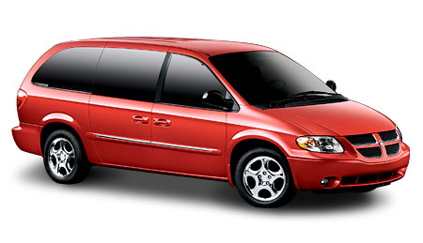
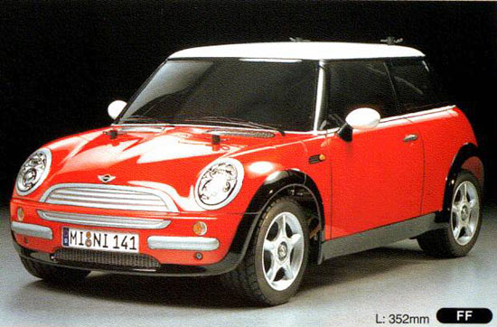
Consumer surplus from the Minivan almost $3B
Mini
Minivan
The total welfare gain from the introduction of the minivan over 1984-1988 was about $2.9 billion, of which $2.8 billion came from consumer surplus.

Slide 14
Some questions to discuss over lunch
Should we prevent firms from becoming dominant so that we always have at least two vigorous firms competing in the market place? (EU Ordoliberal school would seem to favor this.)
Article 101 TFEU prohibits excessive pricing. Shouldn’t the EC enforce these laws vigorously (they don’t now) to prevent dominant firms from charging high prices that reduce social welfare?
What’s the basis for throwing people in jail for price fixing but not for abusing their dominant position? Why does a midlevel Marine Hose executive get a jail sentence for price fixing but Microsoft key executives (e.g. Bill Gates) don’t even get fined personally.

Slide 15
The Design of Competition Rules
How should society design the rules of the competition game to maximize welfare

Slide 16
Antitrust balances short and long-term benefits
Competition policy is “Judicious regulation to bring out the best in ‘laissez-faire’.” (Vickers)
Sets the rules for firms to compete and intervenes when they break these rules. It has a “light” touch.
Antitrust policy in practice usually does not prohibit firms from becoming monopolies or enjoying (many) of the fruits of monopoly power
Places reliance on markets and provides rules that govern competition. Some jurisdictions such as the EU have “exploitative abuses” that could prevent dominant firms from charging “excessive prices” but this s seldom enforced.
Antitrust in practice balances the benefits and costs of static and dynamic competition.

Slide 17
Antitrust considers static v. dynamic tradeoff
Monopolies (or “dominant firms”) are lawful but may have some special obligations in how they compete.
Striving for success, including trying to get a monopoly, is lawful so long as it is based on the merits.
Competition policy generally lets markets work freely but subject to some limitations.
No collusive agreements
Firms can’t engage in certain “anticompetitive practices” that are likely to harm consumers ultimately
Firms can get big organically but we limit their ability to become monopolies through mergers
Notes:
Contestable markets, Demsetz on why regulate utilities…
Competition policy: Markets work except when they don’t
Regulation: market failures exist, regulation is there to make them work “asi fi” they were competitive

Slide 18
Antitrust rules for the game of competition
Boundary for game of competition
Other Clearly Unlawful Practices
Competition rules assess whether the practice is “out-of-bounds”
Lawful Competition in and for the Market
Merger to monopolize or coordinate
Hard-core cartels

Slide 19
Competition rules based on two tradeoffs
Static vs. dynamic efficiency
Tradeoff between increasing static welfare in markets versus increasing dynamic welfare from competition for the markets.
Other costs of decisions include:
Cost of uncertainty faced by businesses in adopting business practices (businesses may prefer clear rules even if those rules err on the side of discouraging pro-competitive practices)
Costs of administration faced by judicial system including legal costs for parties and opportunity costs of the judicial system
False negative vs. false positive decisions
Tradeoff between costs of condemning practices that promote consumer welfare versus allowing practices that harm consumer welfare.

Slide 20
False positive vs. false negative decisions
Given that we don’t have a perfect “test” we need to consider the cost of mistakes which can go two ways (using colorful criminal terminology):
Convicting the innocent (“false positive” aka “Type I error”)
Absolving the guilty (“false negative” aka “Type II error”)
A rule that is “too” easy to violate will discourage pro-competitive practices thereby imposing losses in consumer welfare throughout the economy.
A rule that is “too” hard to violate will not discourage anti-competitive practices enough thereby imposing losses in consumer welfare throughout the economy.

Slide 21
A guide to error-cost terminology
Type I Error | Type II Error
False Positive | False Negative
Court convicts the innocent | Court lets the guilty off
Test says you’re pregnant when you aren’t | Test says you aren’t pregnant when you are

Slide 22
Key counterintuitive result of error cost analysis
The Design of Competition Rules
Tests with modest error rates can have large error costs.
Suppose out of 100, 90% are innocent and10% are guilty
Cost of convicting innocent is $20 and cost of exonerating guilty is also $20
Test has 20% error rate
Cost of convicting innocent is $360 (18 x $20)
If cost of letting guilty go free is less than $45 then it is better to have no prosecutions.
 | Convictions | Acquittals | Total
Innocent (90%) | 18 | 72 | 90
Guilty (10%) | 8 | 2 | 10
Total | 26 | 74 | 90
Analogy in medical tests: test for inoperable cancer with high error rate; better not to conduct test since psychic cost to healthy outweighs cost of letting sick get their affairs in order.
Notes:
CLEAN UPO

Slide 23
Applications of error cost
Antitrust has become more rigorous about predatory pricing because of high cost of prohibiting low prices.
Error cost framework regularly used to think through degree of burden of proof and who bears it.
Recent work looking into mergers and examining whether approvals have had false negatives where price ended up rising significantly.

Slide 24
The Role of Deterrence
Important role of antitrust rules is to discourage firms from crossing the line by punishing those who do

Slide 25
Various ways to discourage violations
Firms considering particular practices will weigh likelihood of detection and cost of being convicted
Society can spend resources on detection
Public
Private Actions
Society can impose penalties on guilty to signal cost to potential violators
Jail
Fines by competition authorities
Damages imposed through private actions
Professional sanctions

Slide 26
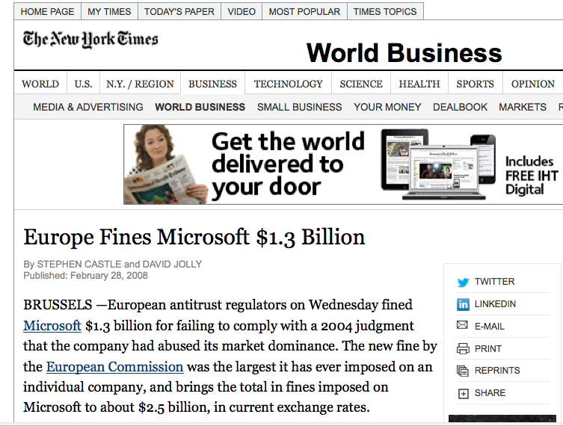
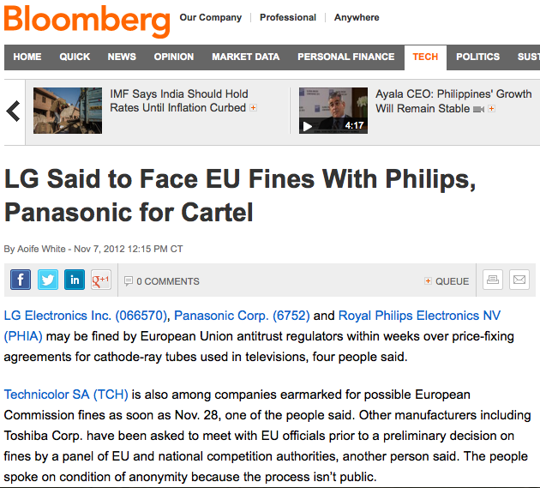
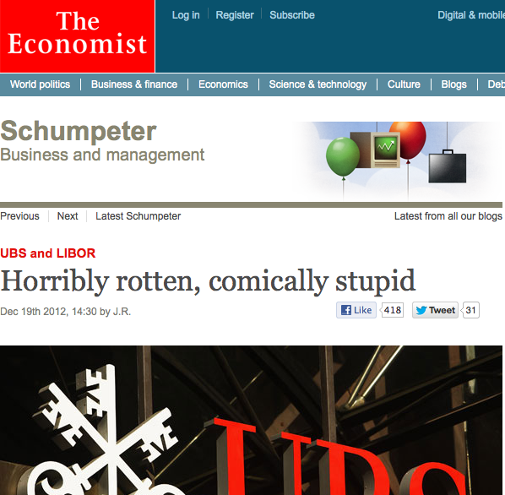
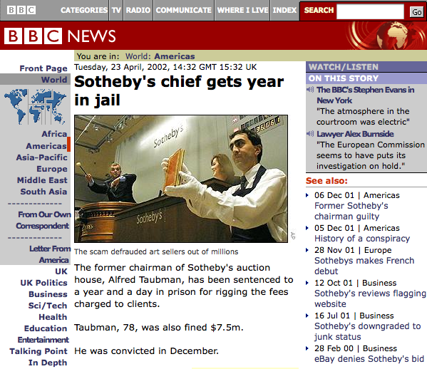
The Role of Deterrence
Notes:
INSERT HEADLINES ANNOUNCING MICROSOFT FINE—LARGEST EVER IN EUROPE. INSERT HEADLINE SHOWING LIBOR FINE FOR UBS.

Slide 27
Rules vs. deterrence
Tradeoff between stricter rules and deterrence resources
Stricter rules:
make detection and conviction easier
may err on the side of “false convictions”
Stricter deterrence:
Increases cost of being detected and convicted
Thereby discourages behavior that might be found unlawful
Notes:
REPLACE WITH OTHER JURISDICTIONS IF YOU CAN’T GET A NUMBER

Slide 28
Competition rules across jurisdictions
We would not generally expect every jurisdiction to have the same competition rules since the factual circumstances that affect the fundamental tradeoffs differ.
Enforcement differences: Competition policy largely enforced through EC and member state authorities; limited private enforcement, limited class actions and seldom multiple damages (so far).
Cultural differences: Cartels condoned by many EC member states until late 1940s; other cultural differences that might make cooperation among competitors more acceptable.
Value differences: EC does not necessarily make same static/dynamic tradeoff and seems to place more emphasis on “fairness” of competition.
Institutional differences: Many state-owned monopolies were privatized but retained market position in EC.
Notes:
Some of the first cases at the CFC (and in Latin American countries) at their inception involved complaints from cartels members who were not complying

Slide 29
Some more questions to discuss over lunch
Should we consider that competition authorities courts make mistakes? Do you think they do much?
Wouldn’t it be cheaper to have extremely high fines and spend less than deterrence?
Is it better to have greater certainty in the rules of the game or more flexibility to reach an accurate decision in a particular case? This is related to object-based vs. effects-based analyses of Article 102 TFEU and per se v. rule of reason approach in US.

